Slide 1
Project – Bake My Cake
Prepared by,
Baskaran A

Slide 2
Problem statements
Design a single page application for Bake my Cake website.
Adhere SRP and DRY principles.
User Interface should be pleasing.
For better user experience, user’s should be able to search and filter the desserts.
Should not allow the user to move away without submit or cancel the order.
For better user experience, user’s should get the proper message after submitting the order.
Order list should be protected. Only accessible to the admin after validating their credentials.
Should handle the invalid url’s.

Slide 3
Commands to setup the project
npm install -g @angular/cli
ng new bake-my-cake
Would you like to add Angular routing - Yes
Which stylesheet format would you like to use - CSS
ng add @angular/material
Choose a prebuilt theme name, or "custom" for a custom theme - Deep purple/Amer
Set up global Angular Material typography styles - Yes
Include the Angular animations module - Include and enable animations
Versions
Angular CLI: 16.2.1
Node: 18.17.1
Package Manager: npm 9.6.7
Angular Material: 16.2.2

Slide 4
Requirements
Components
Services
Models
Header
Footer
Navbar
Dashboard
Search
Filter
Dessert-card
Order-view
Order-details
Order-list
Login-emp
Page-not-found
Dessert service
Router service
Auth service
Auth guard
Can-deactivate guard
Dessert
Order

Slide 5
Components structure
Search
Router-outlet
Dashboard
Filter
Header
Order-view
Dessert-card
App
Navbar
Order-details
Can-deactivate guard
Order-list
Footer
Login-emp
Auth guard
Parent-Child
Guard Injected
Redirect if submission is valid
Page-not-found

Slide 6
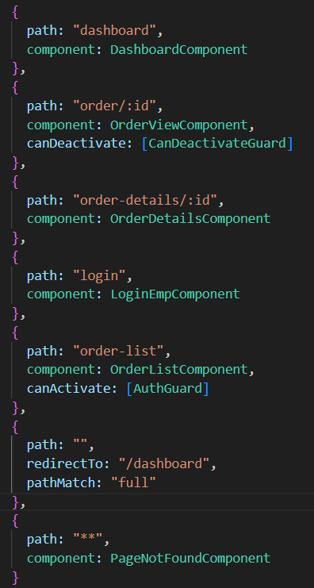
Routes
Navigate to dashboard (Home view)
Navigate to order-view (used to capture the order details)
Navigate to order-details (used to display the order details after the successful submission of the order)
Navigate to login view
Navigate to order-list (used to display all the order details in table structure)
Landing view (redirect to home view when the url path is empty)
Wildcard path (navigate to page-not-found view, when the url path is invalid)

Slide 7
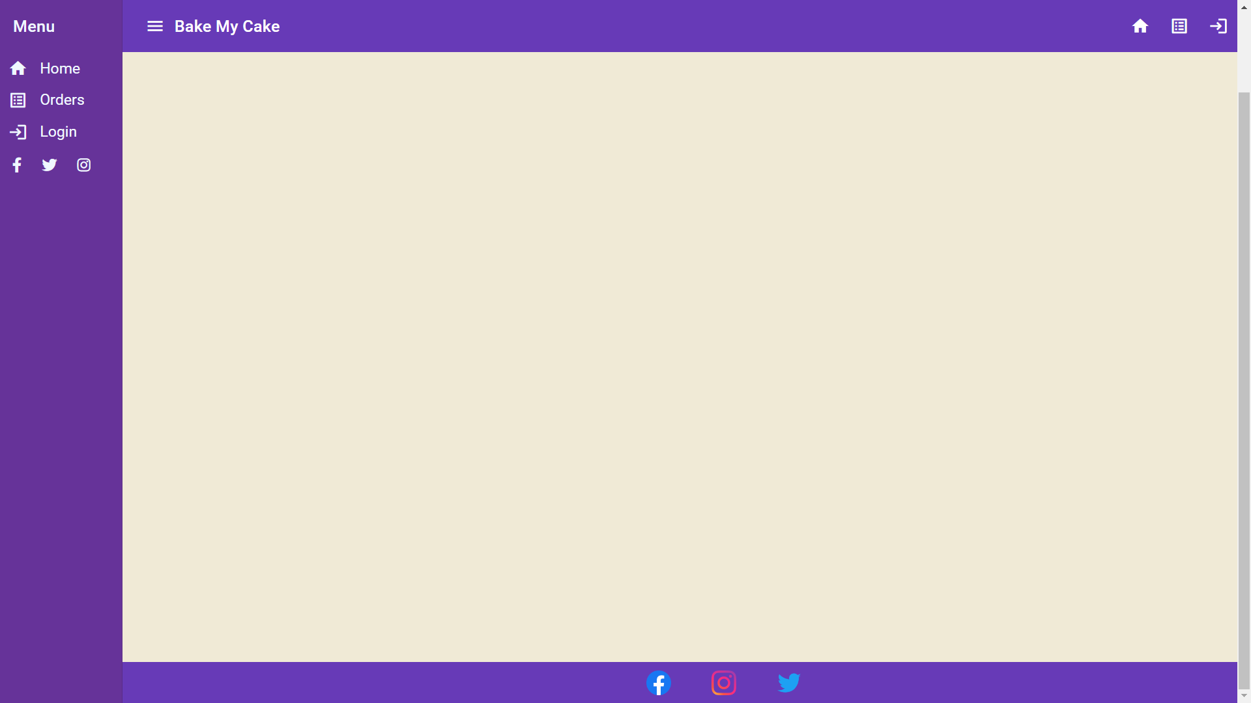
Header
Navbar
Dashboard
Footer

Slide 8
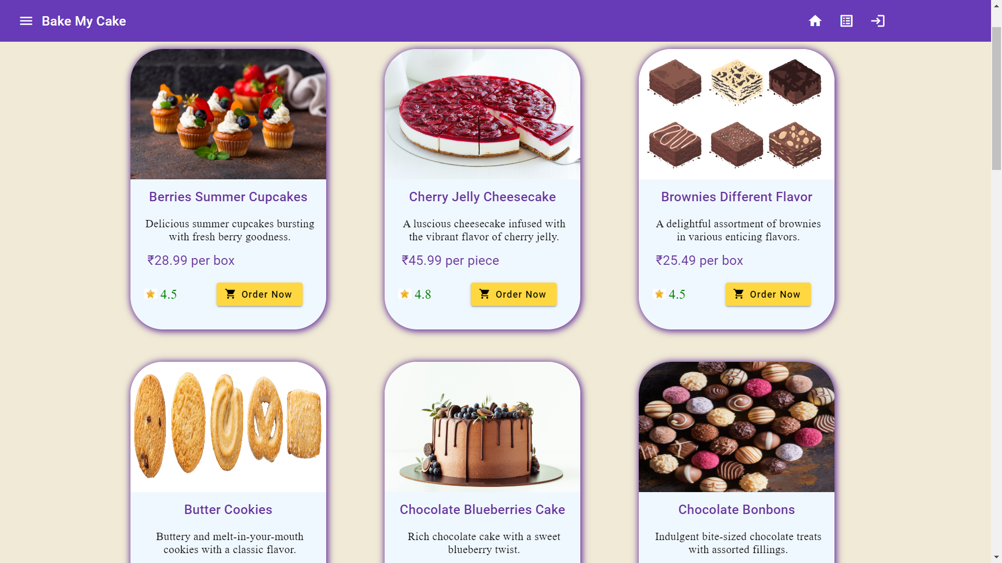
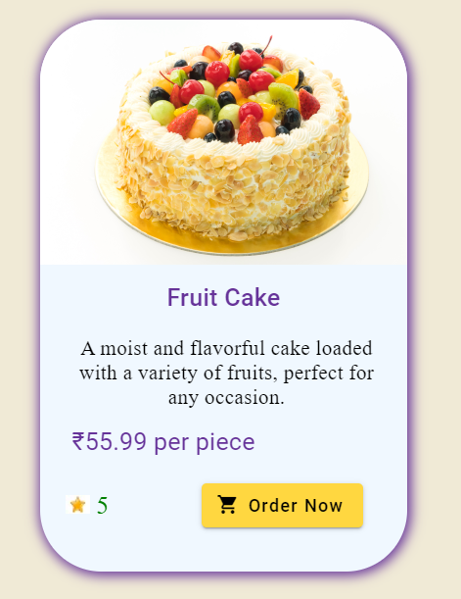
Dessert-card
Responsible for displaying each dessert as cards
Get the data from dashboard component
When the customer clicks “Order Now” button, they will be navigated to the order view component to place the order
Cards in grid structure
Single card

Slide 9
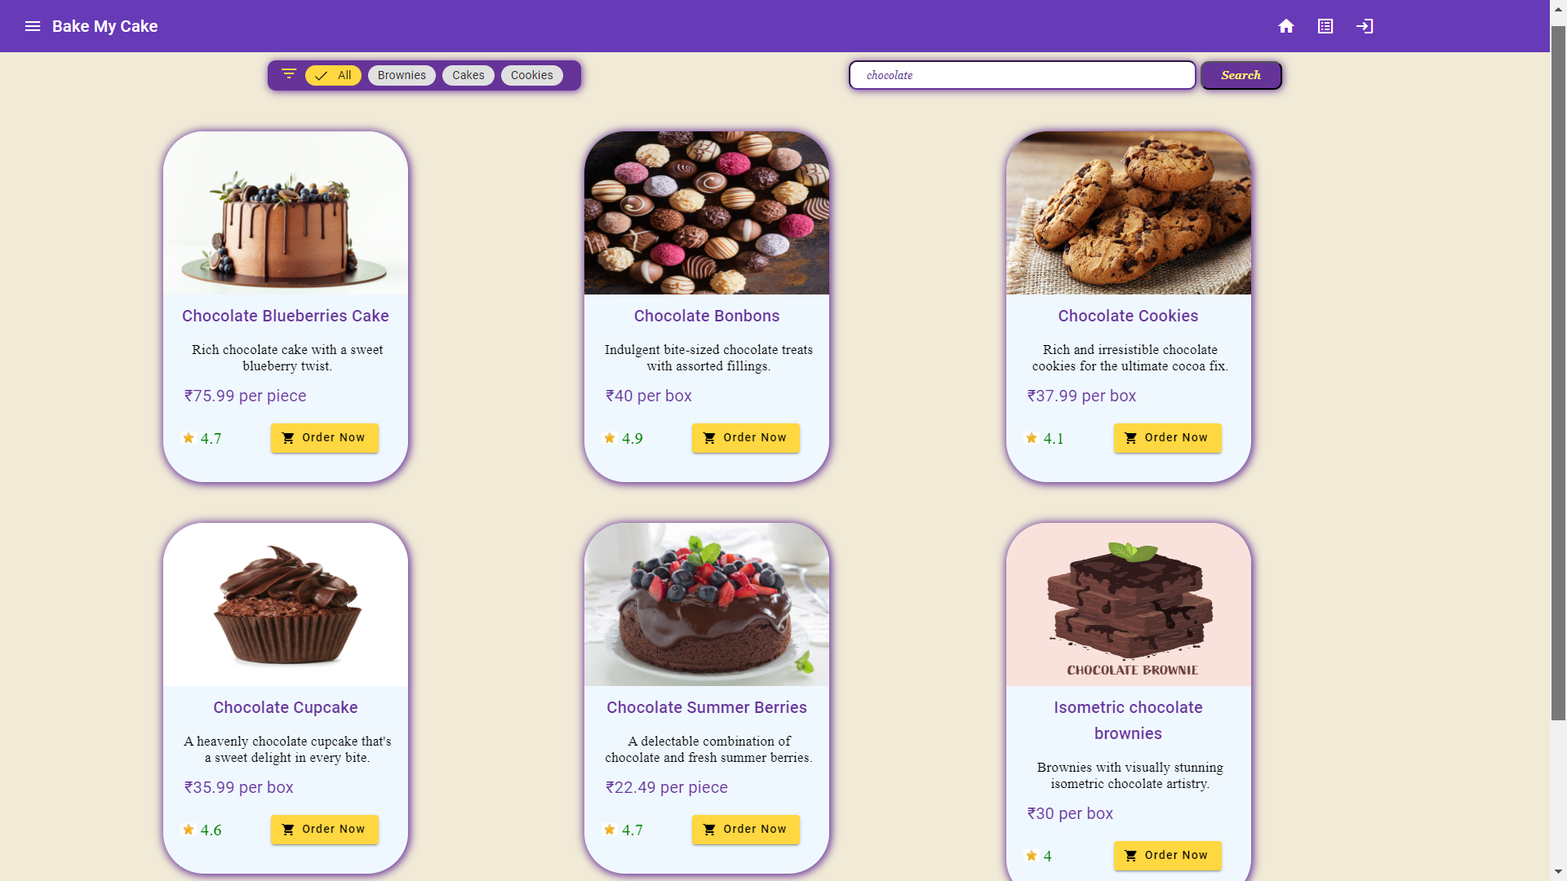
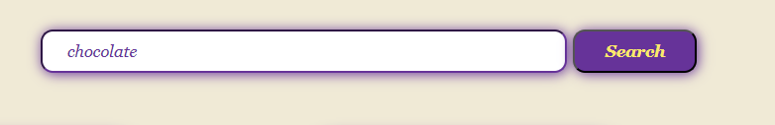
Search
Responsible for displaying search box.
It will emit the data to the dashboard component, when the customer clicks the search button.
Cards when searching “chocolate”
Search box

Slide 10
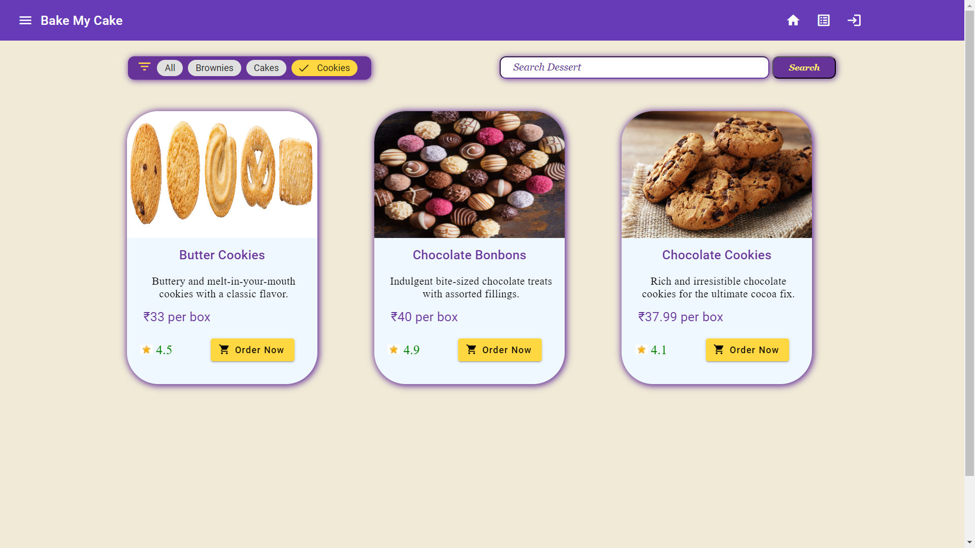
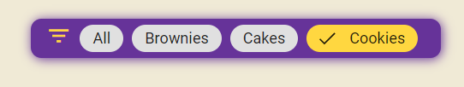
Filter
Responsible for displaying category values as chips, which is used to filter by category.
It will emit the data to dashboard component, when the customer selects the filter category.
Cards when filtered by “cookies”
Filter chips

Slide 11
Order-view
Responsible for accepting the inputs regarding order details from the customer
Reactive forms approach is implemented for getting the inputs
Validations for the form fields are implemented, “Order” button will be enabled once the user give valid inputs for all the form fields.
Can-deactivate guard is implemented
Customer will be asked for a conformation, if they try to navigate to another view without submitting the order.
If customer clicks “Ok”, he/she will be navigating to the requested view and the order will be cancelled.
After the successful submission of order, the customer will be navigated to order-details view, where they can see their order details.

Slide 12
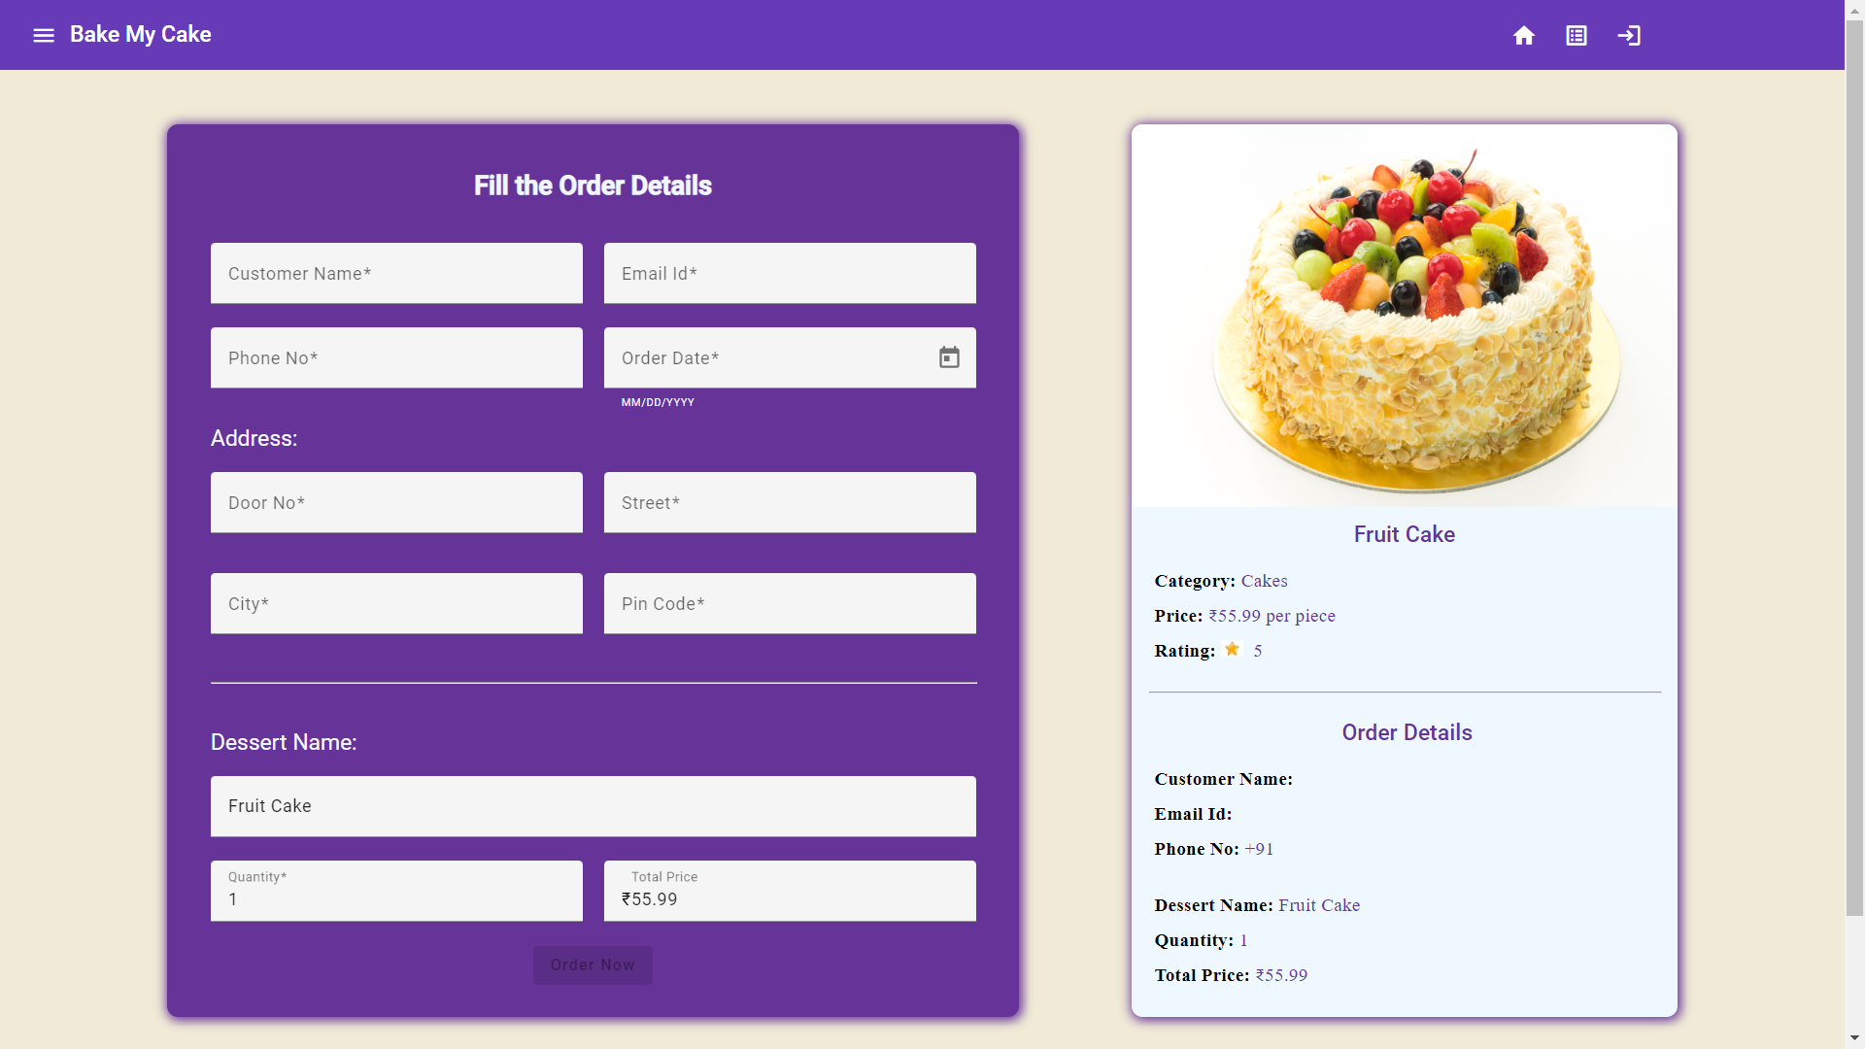
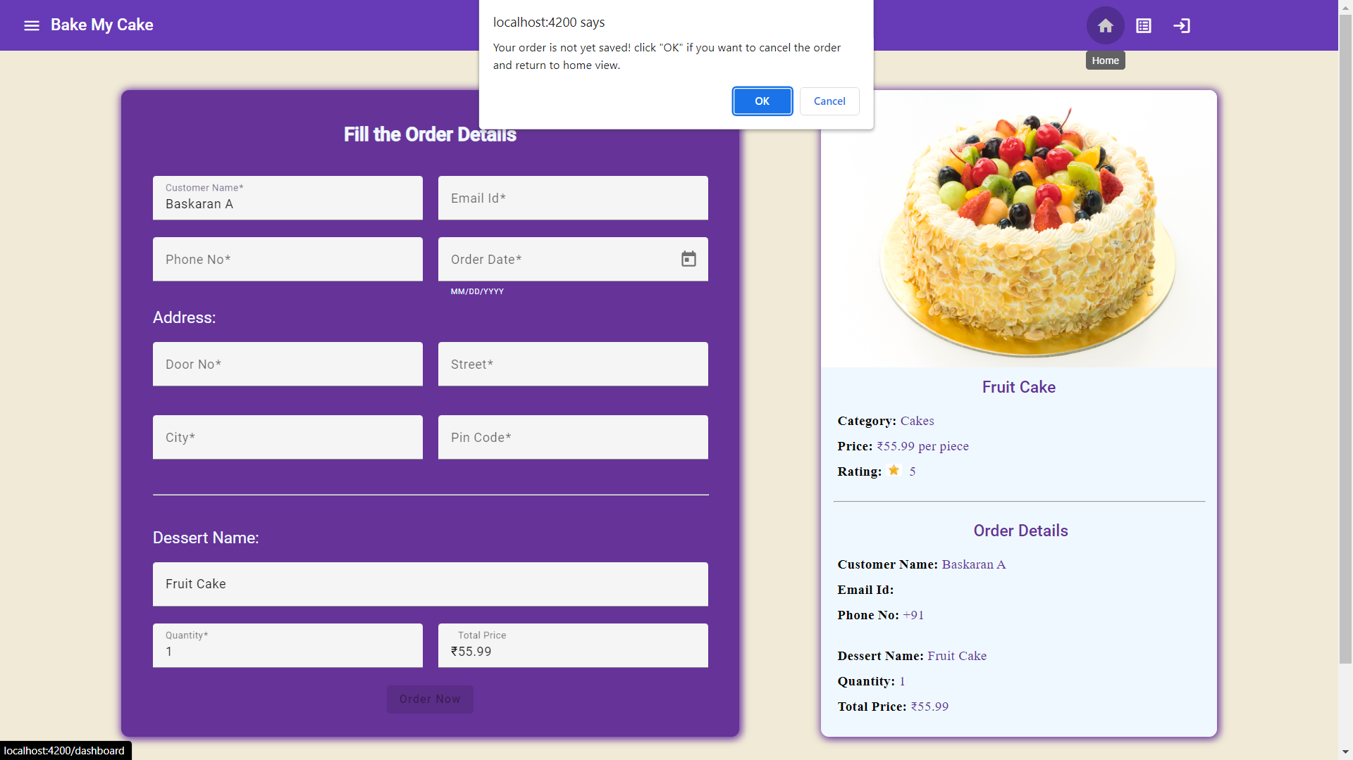
Order-view
When the customer try to move to other view without submitting the order
Order-view when loaded

Slide 13
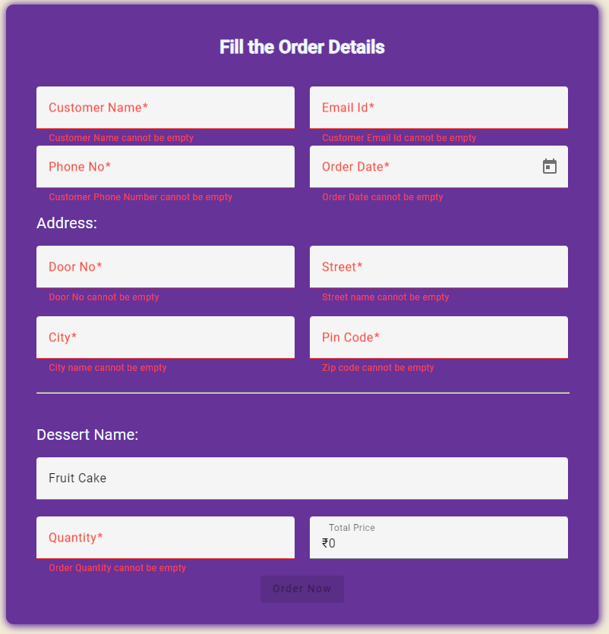
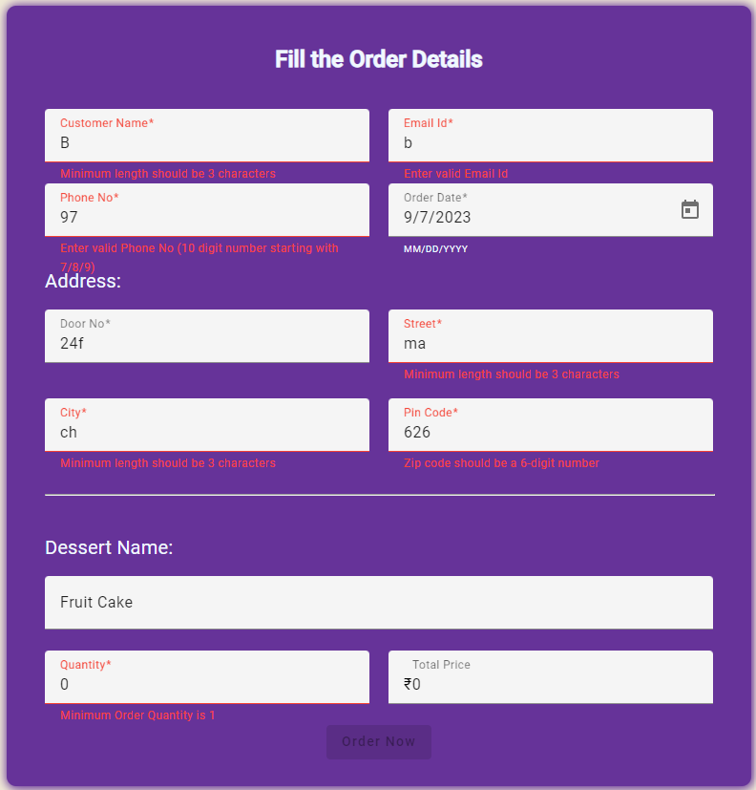
Order-view
Order-view with validations -1
Order-view with validations -2

Slide 14
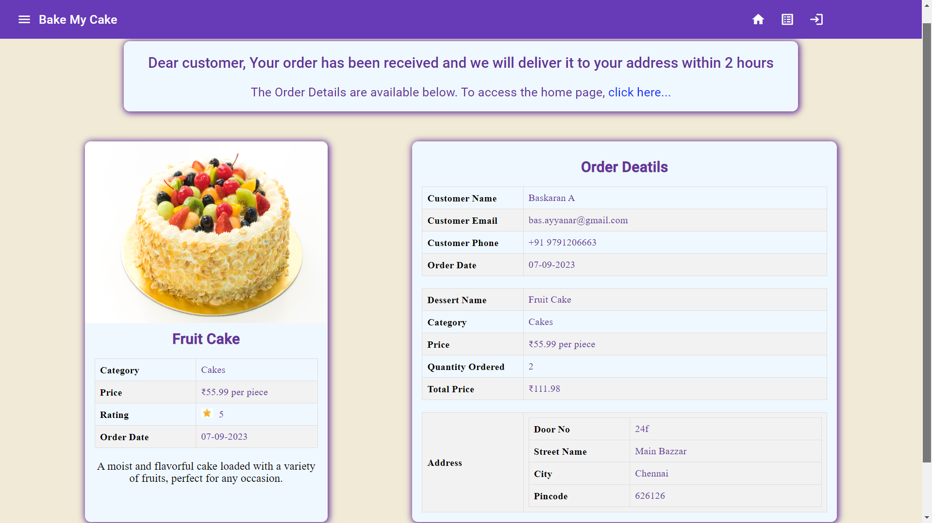
Order-details
After the successful submission of order, the customer can see the confirmation message and order details here.
There is a link for navigate to home view (i.e. Dashboard component view )
Order-details view after the order is submitted

Slide 15
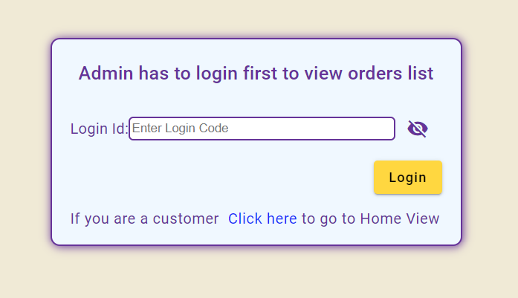
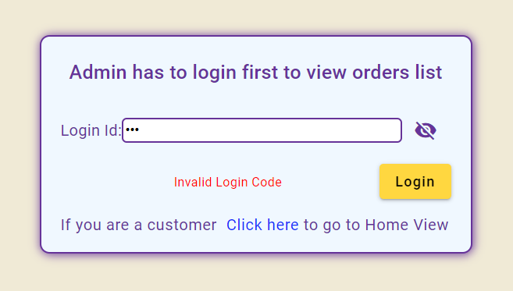
Login-emp
Responsible for validating the login code of the admin. Only the admins have the login code.
After successful login, the admin will be navigated to the order-list view, where they can see all the orders made by the customers.
Login view
Login view with error message for invalid login code

Slide 16
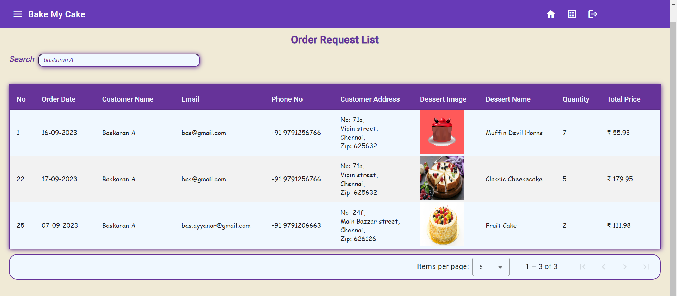
Order-list
Responsible for displaying the order details in table format.
Sort and search functions are implemented for better user experience.
Can-activate guard (Auth guard) is implemented.
When the user try to access this page, they will be redirected to login view.
This view is accessible only when the login code entered by the user is valid.
Order-list view when searching a name

Slide 17
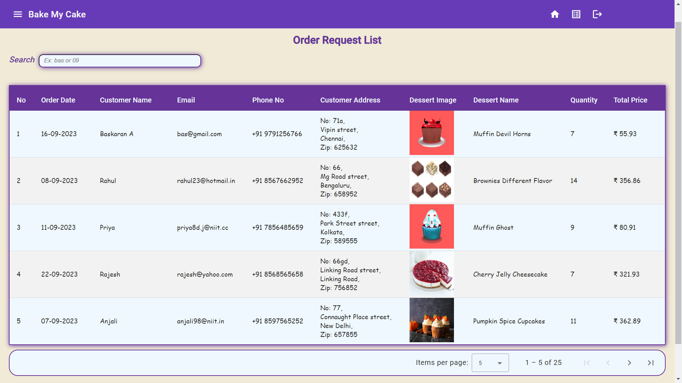
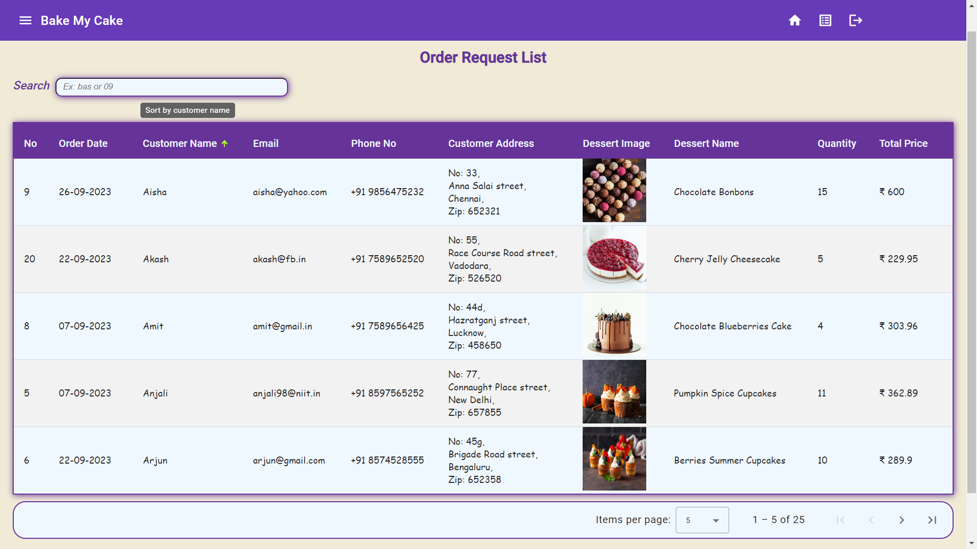
Order-list
Order-list view: orders in table format
Order-list view when sorted by customer name

Slide 18
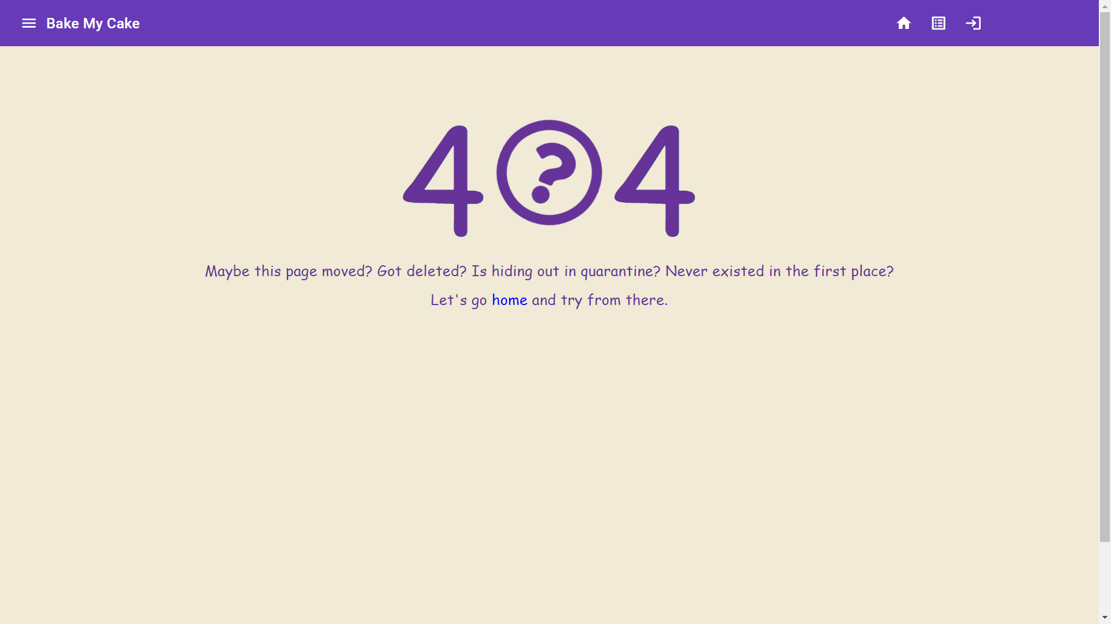
Page-not-found
If the URL path is invalid, the customer will be navigated to this view.
There will be a link to navigate to home view.
Page-not-found view

Slide 19
Conclusion
Single page application for Bake-my-cake is created using angular framework.
Reactive forms were created using for accepting the order details from the customers.
Order details were saved in the server.
Routing implemented to render the different components.
Restrictions for some components were implemented using guards.

Slide 20
Thank You

